Slide 1

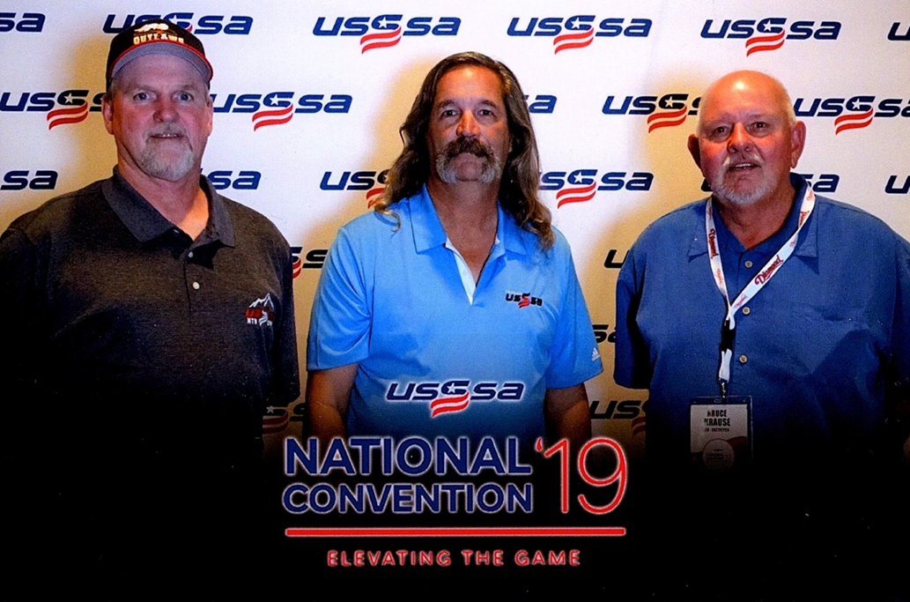
Welcome to the 2021 Season
COLORADO
WYOMING

Slide 2
COLORADO
WYOMING
Silence
Your
Electronic Communication Device

Slide 3









Thank You Veterans & First Responders
COLORADO
WYOMING
Welcome home Vietnam Veterans

Slide 4
Agenda
COLORADO
WYOMING
Opening Remarks
USSSA of Colorado Staff
Recognition
  World Tournament Umpires
  All Star Game
  5, 10, 15 & 20 year Recognition
  Umpire of the Year
Association Treasury Report
Tournament Assigning/Pay
Don’t Call Me Blue
Rule Changes/Discussions
Point of Emphasis
Questions & Answers

Slide 5
USSSA of Colorado and Wyoming Staff
COLORADO
WYOMING
Bruce Krause – Fast Pitch CO/WY State Director
Chris Hunnel – Fast Pitch CO/WY Asst. State Director, Scholarship (All Star) Games Chairman
Larry Neth – Fast Pitch CO/WY State Umpire in Chief (UIC), National Fastpitch Rules Committee Member
  Shelly Westover – Assignor, Treasurer, Umpire Development
  Wally Diede – Fast Pitch Western Slope UIC, Western Slope Director
  Jerry Cox – Fast Pitch Southern Colorado UIC
  Kathy Cox – Fast Pitch Southern Colorado UIC
Fred Flores – Collegiate Program Director, Scholarship Chairman

Slide 6
USSSA of Colorado and Wyoming
COLORADO
WYOMING
Self
Introductions

Slide 7
USSSA of Colorado and Wyoming World Tournament Umpires
COLORADO
WYOMING
USSSA of Colorado provided 5 Umpires to Kansas Elite Select
Umpired 15 games each over 4 days
14U Semi – Plate (1)
16U Semi – Plate (1)
10U Championship – Base (1)
14U Championship – Base (1)
18U Semi – Base (2)
18U Championships – Base (1)
14U & 16U IF Game – Base (2)
Note: Travel paid for by USSSA of Colorado and Wyoming

Slide 8
USSSA of Colorado and Wyoming World Tournament Umpires
COLORADO
WYOMING
Umpires:
  Ann Bolin – 14U Championship game
  Mike Bolin – 16U Semi (P) & IF game (3B)
  Steve Collins – 18U Semi (3B) & Championship game (3B)
  Mark Gwartney – 18U Semi (1B)
  Shelly Westover – 10U Championship, 14U Semi (P) & IF game (3B)
Tournament UIC – Larry Neth
Special Recognition: Ann Bolin – Selected by Victor Canales, National UIC, to Umpire at the U.S. Fastpitch Tournament, Oklahoma City, OK.
Note: We were the ONLY State to have every Umpire in Semi, Championship and/or IF game

Slide 9
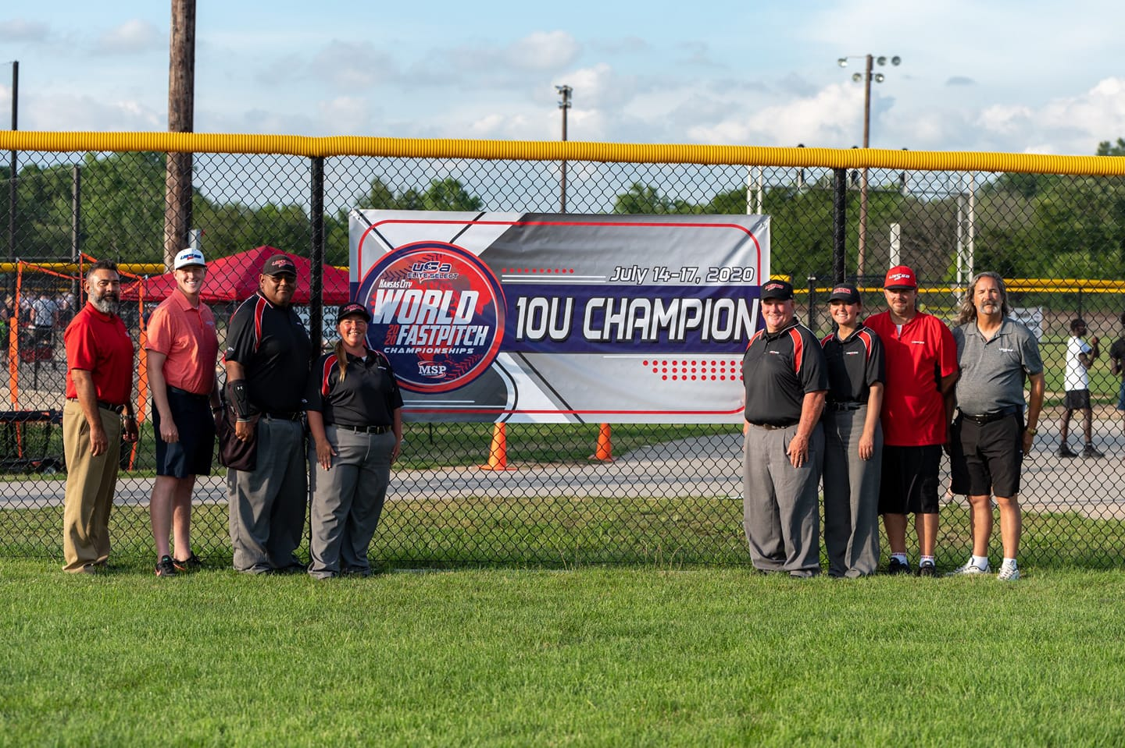
USSSA of Colorado and Wyoming World Tournament Umpires
COLORADO
WYOMING
Left to Right
Victor Canales – National UIC
Austin Mezzacasa – Missouri UIC
Daniel Vega – Kansas (Plate)
Shelly Westover – Colorado (3B)
Joel McCulla – Ohio (1B)
Brooke Perry – Missouri
Paul Hines – Ohio UIC
Larry Neth – CO/WY UIC

Slide 10
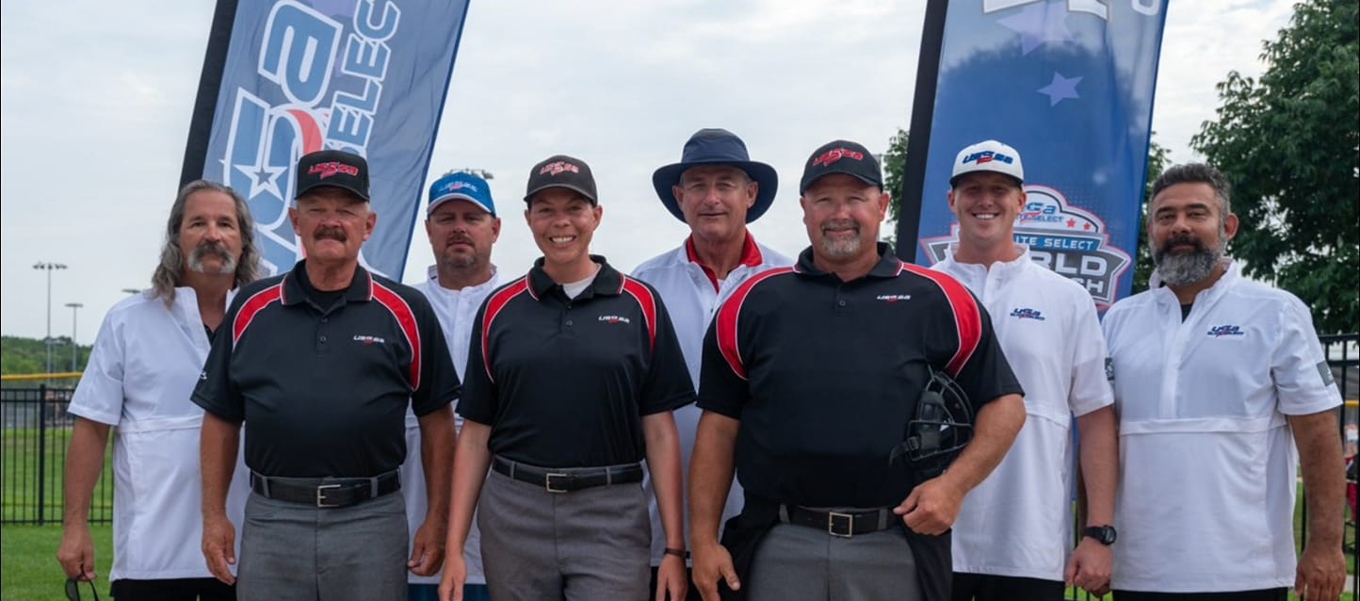
USSSA of Colorado and Wyoming World Tournament Umpires
COLORADO
WYOMING
14U Umpires
Front Row: Kevin Haun – Michigan (3B), Ann Bolin – Colorado (1B), Scott Pierce – Ohio (Plate)
Back Row: Larry Neth – CO/WY UIC, Paul Hines – Ohio UIC, Don Briscoe – Georgia UIC & Rules,
Austin Mezzacasa – Missouri UIC, Victor Canales – National UIC

Slide 11
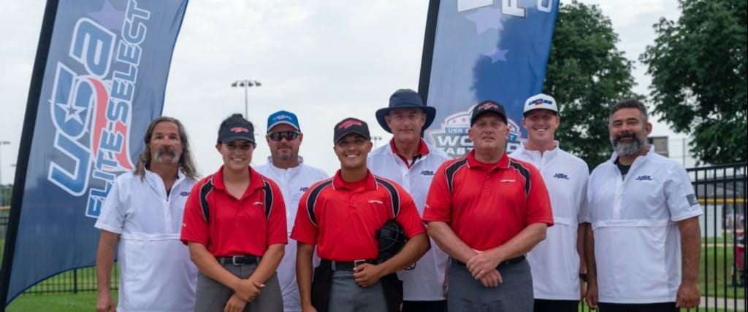
USSSA of Colorado and Wyoming World Tournament Umpires
COLORADO
WYOMING
18U Umpires
Front Row: Allie Krueger – Missouri (1B), Dan Maldonado – Illinios (Plate), Steve Collins – Colorado (3B)
Back Row: Larry Neth – CO/WY UIC, Paul Hines – Ohio UIC, Don Briscoe – Georgia UIC & Rules,
Austin Mezzacasa – Missouri UIC, Victor Canales – National UIC

Slide 12
USSSA of Colorado and Wyoming Umpires
COLORADO
WYOMING
3-Person clinic held at the USSSA Space Coast Complex, Viera (Melbourne), FL.
  J. C. Bartley
  Jon Bartley
  Mark Gwartney
  Brandon Skocz
  Chris Slater
  Shelly Westover
Assistance to other States:
  Mark Pigg – Arizona
  Mark Gwartney - Oklahoma

Slide 13
World Tournament Selection
COLORADO
WYOMING
So, you want to go to a World Tournament?
  Commitment to USSSA of Colorado and Wyoming
  Requirements (National By-Laws Article VI Sec 14)
  Recommended by State and Regional UIC
  Worked USSSA of Colorado fast pitch minimum 3 yrs.
  Worked 85% of USSSA of Colorado/Wyoming Tournaments
  MUST WORK “Big Tournaments” & STATE TOURNAMENT(S)
  Rule Knowledge
Inform via email the State UIC (Larry) if interested.
  Commitment to USSSA of Colorado and Wyoming
  Observation and critique by UICs
  Appearance & Mechanics
  Demeanor – On & Off Field
  Tournament Availability (Local, State & World)
    Commitment to USSSA of Colorado and Wyoming
  Final Approval: State Director & UIC

Slide 14
World Tournament Selection
COLORADO
WYOMING
World Tournament(s)
  Waiting for requests from Tournament Directors.
  Dates: June 21 – August 1 (Location dependent)
World Tournament Uniforms Standard:
  Article VI Sec 14.D – World Series UIC will determine uniform requirements. Shirts: Red, White and/or Black; Hats: Black Hat w/ Red USSSA logo; heather grey pants, Black Ball Bag.
In Colorado & Wyoming the Uniform is RED shirt, Black hat w/red lettering & white trim, HEATHER GREY pants, black ball bag.
Note: You will be required to have the BOOMBAH uniform for tournaments outside of CO & WY

Slide 15
USSSA Scholarship/All Star Game
COLORADO
WYOMING
USSSA of Colorado Fast Pitch Umpires
No Scholarship awarded/No All Star Game
2021 goal: $2000.00
  UIC Staff & Assignor Pledge $300.00
  Donations from Umpires
    Cash, Check, withhold from pay
    Bruce, Larry, Chris Hunnel or ask Shelly Westover to withhold

Slide 16
USSSA of Colorado and Wyoming – 5, 10, 15 Year Recognition
COLORADO
WYOMING
Five Years
Ann Bolin
Bill Feller
Ten Years
Joe Lucero
Chuck Smith
Dan Tocci
Fifteen Years
John Smithson AND

Slide 17
USSSA of Colorado and Wyoming – 15 Year Recognition
COLORADO
WYOMING
Bruce Krause

Slide 18
USSSA of Colorado and Wyoming – 20 Year Recognition
COLORADO
WYOMING
Huge Milestone!
4 Umpires
Receiving:
  20th Year Jacket, 20th Year Pin, Special Certificate, Commemorative Pint Glass & their registration paid for this year

Slide 19
USSSA of Colorado and Wyoming – 20 Year Recognition
COLORADO
WYOMING
Jerry Cox
Kathy Cox
Art Sonka
Shelly Westover

Slide 20
Umpire of the Year and Committee Members
COLORADO
WYOMING
2002 – Larry Neth
  2014 National Umpire of Year
2003 – Paul Roberts (COHoF)
2004 – Charles Algiene
2005 – Mark Bragazzi
2006 – David Hutchinson
2007 – Greg Hastings
2008 – Dallas Cress
2009 – Bill Grey
2010 – Reuben Maes
2011 – Rocky McVicker
2012 – Jack Acord
2013 – John Smithson
2014 – Shelly Westover
2015 – Chris Tourscher
2016 – Steve Collins
2017 – Jason Cross
2018 – Mike Tomlinson
2019 – Ken Salvucci
2020 - ???

Slide 21
USSSA of Colorado and Wyoming – Umpire of the Year
COLORADO
WYOMING
Requirements:
Active for 5 yrs USSSA of Colorado/Wyoming (Begin 2021 – 3 years)
Tournament participation – 85%
  Includes the “big tournaments” & States
Rule Knowledge – USSSA & Tournament
Mechanics
Professionalism/Respect – Coaches, Umpires
Appearance – Proper uniform, cleanliness

Slide 22
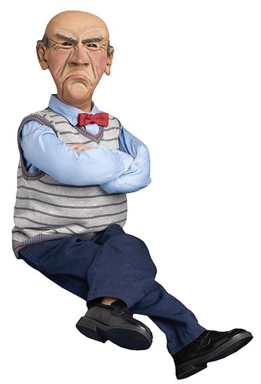
USSSA of Colorado and Wyoming – Umpire of the Year
COLORADO
WYOMING
Photo provided by:
Bill Grey
2009 Umpire of Year
2020 – 20 Years USSSA

Slide 23
USSSA of Colorado and Wyoming – Umpire of the Year
COLORADO
WYOMING
2020 USSSA of Colorado
Fast Pitch Umpire of the Year
Joseph “Doc” Ryan

Slide 24
USSSA Registration, Background Checks & Insurance
COLORADO
WYOMING
Effective January 1, 2020 All Directors, Officials & Coaches
Registration and Background Checks Every Year
Everyone working USSSA must be registered and completed successful background check
Registration includes insurance
Background checks due to Senate Bill S.534 “Protecting Young Victims from Sexual Abuse and Safe Sport Authorization Act of 2017 (Resulted from Michigan State/U.S. Olympics) http://www.usssa.com/safesport
USSSA has partnered with SafeSport

Slide 25
Colorado USSSA Umpire Association, LLC
COLORADO
WYOMING
Established 2018
We are a 501c3
Registered to the Federal IRS and Colorado
Everyone is a member in good standing when registered
Chairperson – Larry
Treasure – Shelly
Pay/1099’s will come through the LLC via ZebraWeb/Z-Pay

Slide 26
USSSA of Colorado and Wyoming Tournament Pay
COLORADO
WYOMING
PAY RAISE!!!
Two Umpires - $50.00/Umpire/game
  Championship - $55.00/Umpire
Single Umpire - $75.00/game
  Championship - $80.00/game
Scheduled 90 minute game
  $55.00/Umpire/game
  Championship - $60.00/Umpire
*** Full Time UIC $200.00/day ***Exception: Friendlies/Scrimmages
****Every Umpire Receives the SAME game fee****

Slide 27
USSSA of Colorado and Wyoming Tournament Pay
COLORADO
WYOMING
Beginning 2018: Your tournament pay WILL NOT be negotiated!
Tournament wants “fund-raiser” so be it. Our pay remains the same.
You want to donate your pay to tournament? WRITE A CHECK!
Do not tell T.D. that you’ll donate your game fee! There are other “fees” attached to the contract.

Slide 28
USSSA of Colorado and Wyoming Tournament Pay
COLORADO
WYOMING
Pay
All pay will be handled through ZebraWeb/iSolve
Zebra Web is an officials assigning and pay system
Similar to Arbiter, but costs less
We will be using the assigning platform
We also will use their pay system.
  Direct Deposit into your checking account
  NO MORE CHECKS!
  W9’s are covered by ZebraWeb
  1099’s are covered by iSolve

Slide 29
USSSA of Colorado and Wyoming Tournaments
COLORADO
WYOMING
USSSA of Colorado will continue to supply Water and Gatorade at tournaments
$561.26 – Spent on Water, Gatorade, Ice in 2020
Please send (text) copy of receipts to Shelly. No receipt – no reimburse!

Slide 30
USSSA of Colorado and Wyoming Treasurer Report
COLORADO
WYOMING
Beginning Balance: $8243.51
EXPENSES:
  State Business Renewal: $10.00 (for 2021)
  ZebraWeb: $2534.16 (includes 2020-21)
  Umpire of Year Trophy: $143.00
  20yr Items/Flip Coins/Pins: $1165.15 (includes 2020-21)
  Staff Registration: $480.00
  LineUp Card Holders: $317.57
  Wire Transfer (Delinquent Director): $15.00
  Hotel: $134.08
  Taxes: $33.00
  Truthfinder: $67.00 (includes 2020-21)
  Stamps: $176.00
  Admin: $500.00
  Total: $6136.22
Ending Balance: $2107.29

Slide 31
USSSA of Colorado and Wyoming Tournaments Assigning
COLORADO
WYOMING
  We will begin with Google Invite and ZebraWeb.
  Eventually we’ll “retire” Google Invite. All availability/assigning thru Z-Web.
  Shelly will send out invites up to 10 days prior to the tournament. Everyone will receive an email. It is IMPERATIVE that you respond (yes, no and if hotel needed).
  ((Note: We know there were issues in receiving or RSVP. Contact Shelly if you haven’t received an invite or having problems sending.))
  Tournament Directors must have matrix to Shelly two weeks prior to tournament
  ANY CHANGE contact Shelly immediately via TEXT, PHONE or EMAIL. (Include State UIC on TEXT/EMAIL).

Slide 32
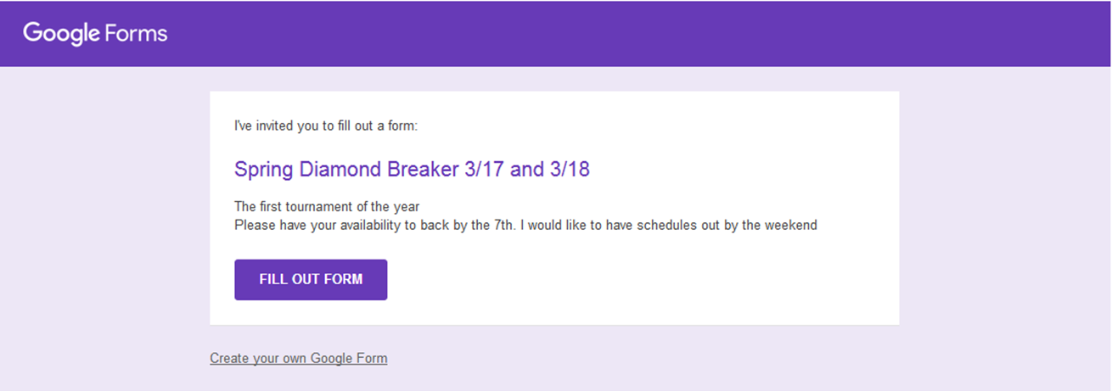
USSSA of Colorado and Wyoming Tournaments Google Invite
COLORADO
WYOMING

Slide 33
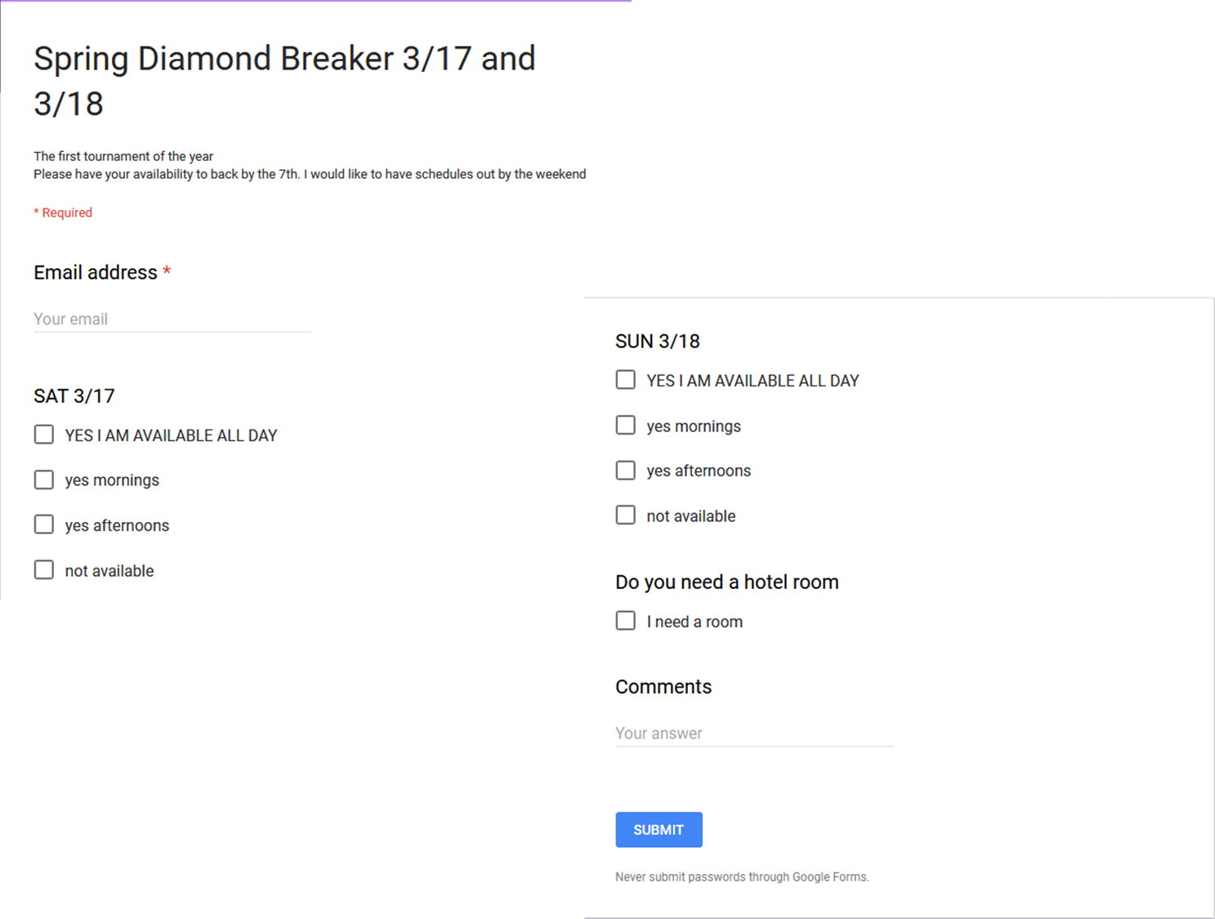
USSSA of Colorado and Wyoming Tournaments Google Invite
COLORADO
WYOMING

Slide 34
USSSA of Colorado and Wyoming
Tournament Hotels
COLORADO
WYOMING
Hotels are provided and paid by the tournament
Our policy:
  50 miles or 60 minutes driving distance/time from your home to complex
  Two umpires per room
  Rooms are for Saturday night only
    EXCEPTION: Driving more than 75 miles or 90 minutes, subject to tournament director’s approval, a room may be available on Friday night. YOU MUST INFORM Shelly & Larry if you want a room for Friday. (Don’t assume)
  Request a room and don’t use it:
    First offense – you’ll pay half if there’s a roommate, all if there isn’t a roommate
    Second offense – payment same as above and you’re no longer eligible for a room

Slide 35
USSSA of Colorado and Wyoming
Tournament Cancellation/Delay
COLORADO
WYOMING
First Rule: This is Colorado! Inclement weather at home? May not be at ballfield(s). DO NOT CALL/TEXT Shelly. Tournament Director & Shelly in contact.
Cancel or Delay?
  Shelly will text/email the first game umpires of complex affected, first. Everyone else after.
  Delay – You’ll be informed of how long. Note: Tournament Directors will attempt to get games back “on time”. So, incoming Umpires plan on being on-time as scheduled. You’ll be informed of any other changes as they occur.
  Cancellation: Saturday DOES NOT mean Sunday. If a complex is cancelled, another complex/field may be available. We’ll move Umpires to those complexes.
Bottom Line: We’re in contact with Tournament Directors. Give us time to find out the situation. Phone calls/texts to UIC/Assignor delays us getting information out to you! Please be flexible.

Slide 36
USSSA of Colorado and Wyoming
Tournament Parking
COLORADO
WYOMING
Park as a group
  PARK WITHIN THE CONES!
  Safety in Numbers
  Away from Players/Parents/Fans
  Be aware of your surroundings (Voices carry)
  Be discreet
  Clean up after yourself – UIC’s ARE NOT the Custodial Crew! (Leave the place the way we found it or better!)
  No Alcohol consumption at complex!
  Before, during or AFTER!

Slide 37
USSSA of Colorado and Wyoming
Tournament UIC
COLORADO
WYOMING
  You’ve been selected as a Tournament UIC
  More is expected of you.
  Tournament UIC represents the State UIC
  Selection is based on:
    Experience
    Rule Knowledge
    Professionalism
    Personality
    Communication Skills

Slide 38
USSSA of Colorado and Wyoming
Tournament UIC
COLORADO
WYOMING
Contact Shelly – Is last weekend UIC at complex?
Pick up water, Gatorade, ice
Copy of Umpire schedule
State UIC phone number
Tournament Weekend
State UIC Phone Number
Umpire Schedule
Meet w/ T.D. or Reps
Provide your phone number
Have Rulebook (hard copy)
Have Tourney Rules
Game Balls
Field/Weather Conditions
Late/No Shows
Any Issues***
Ejections
Observations
Training
All Umpires properly dressed
Post Tournament
Report to State UIC
Receipts/drinks left to Shelly

Slide 39
USSSA of Colorado and Wyoming
Umpire Uniform
COLORADO
WYOMING
RED Boombah Official Polo Shirt
Exposed sleeves MUST match the polo shirt
HEATHER GREY pants
BLACK Boombah Umpire Jacket
ALL BLACK hat with Red letters
Black ball bag
Predominantly BLACK shoes (polished)

Slide 40
USSSA of Colorado and Wyoming
Umpire Uniform
COLORADO
WYOMING
  The Association provided lineup card holders and flipping coins when you entered the meeting.
  We’re USSSA. We should not be seeing other organizations items at our tournaments.
  Other cardholders that don’t “promote” other organizations is acceptable
  Pride and professionalism
  Umpires who were unable to attend the meeting will receive their cardholders and coins at tournaments.

Slide 41
USSSA of Colorado and Wyoming
USSSA Fastpitch Rules – 15th Edition
COLORADO
WYOMING
The rule book is printed every 2 years.
  (Except when there is a pandemic) New printed book in 2022.
  Current book is 15th Edition
“The On-Line Rule Book Supersedes the Printed Edition” (page 6)
Any rule changes that occur during the season will be sent to all USSSA of Colorado Fast Pitch Umpires via email by the State UIC

Slide 42
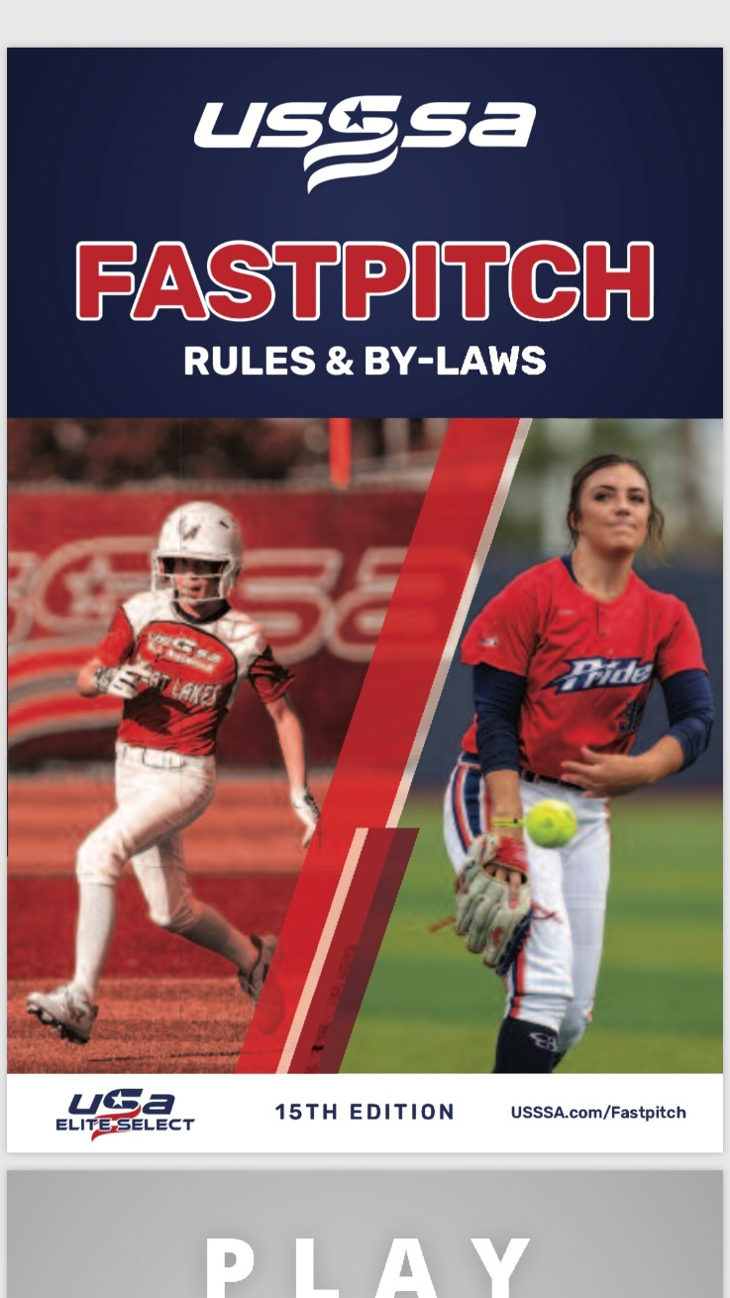
USSSA of Colorado and Wyoming
USSSA Fastpitch Rules – 15th Edition
COLORADO
WYOMING
Page 1 states:
Fifteenth Edition
Printed 1-2019.
On the bottom of each page:
15th Edition (Printed 1-2019)

Slide 43
USSSA of Colorado and Wyoming
USSSA Fastpitch Rules 15th Edition Changes
COLORADO
WYOMING
Changes effective January 1, 2020 (No changes for 2021)
Not really changes, but enhancements
Page 3 Leadership Team
  David Maury replaced Dr. Charles Beckwell, DDS as National Director of Officials (Softball and Baseball)
Rule 6 Sec 1 – Modifies Requirement for Pitcher’s Foot Placement
Rule 6 Sec 1A-I Effect
Rule 6 Sec 1J – Enhances Penalty for Intentional Illegal Pitch

Slide 44
USSSA of Colorado and Wyoming
USSSA Fastpitch Rules 15th Edition Changes
COLORADO
WYOMING
Rule 12 Sec 1 – Clarifies Coach Sit-out for Ejection
Rule 17 Item 8 – No Bunting in Coach/Machine Pitch
Bylaw Art VI, Sec 2B – Note, pertains to World Tournament Play. Home/Visitor Choice

Slide 45
USSSA of Colorado and Wyoming
USSSA Fastpitch Rules 15th Edition Changes
COLORADO
WYOMING
Rule 6 Sec 1 – Modifies Requirement for Pitcher’s Foot Placement
  Prior to the pitch, the pitcher shall take a position with their pivot foot in contact with the pitcher's plate and their non-pivot foot in contact with or behind the pitcher's plate. Both feet must be on the ground within or partially within the 24-inch length of the pitcher's plate.
Rule 6 Sec 1A – I Effect
  Illegal Pitch

Slide 46
USSSA of Colorado and Wyoming
USSSA Fastpitch Rules 15th Edition Changes
COLORADO
WYOMING
Rule 6 Sec 1J – Enhances Penalty for Intentional Illegal Pitch
  Rule 6 Sec 1J: The pitcher shall not deliberately drop, roll, bounce, etc, the ball while in the pitching position in order to prevent the batter from striking it.
  PENALTY: The ball is dead at the end of playing action. The batter is awarded a ball which may be declined by the offensive coach. FIRST OFFENSE is a team warning. SECOND OFFENSE and any subsequent violation the offender is restricted to the bench for the remainder of the game and their current head coach shall be ejected.

Slide 47
USSSA of Colorado and Wyoming
USSSA Fastpitch Rules 15th Edition Changes
COLORADO
WYOMING
Rule 12 Sec 1 – Clarifies Coach Sit-out for Ejection
Sec 1. A coach/manager who is ejected shall leave the vicinity (out of sight and out of sound) of the playing area immediately and is prohibited from any further contact (direct or indirect) with the team during the remainder of the game. The ejected coach/manager must sit out the remainder of that game and the following game which must be actually played (i.e. - a non-played forfeit game will not satisfy the sit out requirement). They are barred from coaching in the tournament until that team has completed their next game.

Slide 48
USSSA of Colorado and Wyoming
USSSA Fastpitch Points of Emphasis
COLORADO
WYOMING
Tournament Rules
USSSA of Colorado and Wyoming Tournaments are non-protest tournaments!
  Umpires decisions are final
    There’s two umpires on the field. Get together.
“Be decisive. Right or wrong, make a decision. The road of life is paved with flat squirrels who couldn’t make a decision.”
    ~unknown~

Slide 49
USSSA of Colorado and Wyoming
USSSA Fastpitch Points of Emphasis
COLORADO
WYOMING
Our tournaments use two sets of rules
  Bat your line-up (Roster Batting) or CO/WY Book Rule
  We DO NOT use Rule 5.2A (“continue dropping batters till below 8”)
Roster Batting – Team has option of batting their roster or not.
  Having only 9 players is considered batting your line-up
  Teams MUST submit LINE-UP cards at pre-game.
  Pitch and Catcher must be designated.
  Courtesy Runner is the Last Completed at Bat (LCAB)
  DEFENSE has “free substitution”
  Team may play short-handed (ONE LESS PLAYER) and take an out when batting
  Lose another player – game over.

Slide 50
USSSA of Colorado and Wyoming
USSSA Fastpitch Points of Emphasis
COLORADO
WYOMING
CO/WY “Book Rule”
  NO BAT YOUR LINEUP (Roster Batting)
  Standard/traditional batting lineup
  9, 10 or 11 batters. Max number of players in lineup 12, max batters 11
  CR begins with substitutes before switching to LCAB
    9 players only (no substitutes) team uses LCAB
  NO “free substitutes”. All substitutes must be reported to Plate Umpire
  Can start with 8 players. Lose a player, game over.
  Short-handed rule in effect. Team loses 1 player an out is taken when at due bat. Lose another player, game over.

Slide 51
USSSA of Colorado and Wyoming
USSSA Fastpitch Points of Emphasis
COLORADO
WYOMING
Non-batting your roster (aka CO/WY “Book Rule”)
Line-up can have DP/Flex and up to 2 Additional Players (AP)
  Must be on line-up card at pregame conference.
  APs must bat and can be anywhere in the line-up, except the LAST spot on card if using DP/Flex
  Flex is the last player on the line-up card
  Flex is a non-batting position except when “substituting” for DP
  APs are players. They can move in/out on defense without penalty.

Slide 52
USSSA of Colorado and Wyoming
USSSA Fastpitch Points of Emphasis
COLORADO
WYOMING
Chalk or Dirt?
Pitcher can use DIRT as a drying agent.
Pitcher can use powdered resin or an approved drying agent.
Pitcher CANNOT apply these items DIRECTLY to the ball.
Pitcher not required to “wipe-off”
Pitcher uses chalk – Illegal pitch (Note: be “liberal” at the beginning of the season. 1st time “kindly” remind the pitcher that she can’t use chalk)
Rule 6 Sec 1.I.1

Slide 53
USSSA of Colorado and Wyoming
USSSA Fastpitch Points of Emphasis
COLORADO
WYOMING
Pitching Rule 6.1A (Change made in 2020)
Pitcher starts with pivot foot IN CONTACT WITH pitching plate
  In contact with does not mean ON TOP, Pitcher can “heel-up) to front of pitching plate
Non-pivot foot may be in contact with OR BEHIND pitching plate
  Pitch has option of starting in contact or behind and step back.
  The step back can before, during or after “hands come together”
  Step back CANNOT occur when the pitch begins. (Pitch begins when one hand is taken off ball or pitcher makes motion that is part of windup after the hands have been brought together) (Rule 6.1E)

Slide 54
USSSA of Colorado and Wyoming
USSSA Fastpitch Points of Emphasis
COLORADO
WYOMING
Courtesy Runner (CR) Rule 8.3
– Unreported vs. Illegal
  In USSSA the team may use the same CR to run for the Pitcher or Catcher. NOT IN THE SAME INNING!
  Must use substitute first. No subs or all subs have played then, Last Completed at Bat (LCAB) (Rule 8.3B)
    LCAB is NOT necessarily the last out.
  Illegal CR (aka ineligible or incorrect) Penalty: Discovered while still on base, CR is out & team warning (first offense). Second offense: Head Coach (HC) ejected for remainder of game only. (Rule 8.3B Penalty)
  Unreported CR – same as Unreported Sub. First offense, enter player & team Warning. Second – enter player, Eject HC (Rule 8.3G Penalty & 5.5 Penalty)

Slide 55
USSSA of Colorado and Wyoming
USSSA Fastpitch Points of Emphasis
COLORADO
WYOMING
Last Completed at Bat (LCAB)
  Used as CR for pitcher and/or catcher
  Must follow the Rule for CR (hint: can’t run for P or C in same inning)
  If no substitutes or all substitutes have entered the game
  The LCAB is NOT necessarily the last out
  If the LCAB is the pitcher or catcher – move up the line-up
  If a CR is needed in first inning – use the last batter (LCAB) in lineup
  Avoid putting LCAB on base if due up.
  In all cases of CR or LCAB – GET THE LINEUP CARD OUT
    Preventive Umpiring

Slide 56
USSSA of Colorado and Wyoming
USSSA Fastpitch Points of Emphasis
COLORADO
WYOMING
CR or LCAB injured when on base
  Another CR, LCAB or Pitcher or Catcher may run until they score or are put out.
Player injured on base and substitute was used as CR and no other substitutes available
  If CR is in dugout, that former CR becomes the substitute for injured player
  If CR is on base, player she is CR for (P or C) enters for CR and CR becomes substitute for injured player
A player that is replaced due to injury CANNOT return to THAT game.

Slide 57
USSSA of Colorado and Wyoming
USSSA Fastpitch Points of Emphasis
COLORADO
WYOMING
Bat Checks will continue. Look completely at bat.
Once a year a “double-marked” bat appears
BAT, NON-APPROVED. A non-approved bat is a bat that does not bear the current USSSA 1.20 BPF “thumbprint” certification mark, or a bat that is listed on the USSSA Withdrawn/Non-Compliant Bat List. EXCEPTION: Wood bats per 2-10-D.
Example: Easton GHOST, DeMarini PRISM

Slide 58


USSSA of Colorado and Wyoming
USSSA Fastpitch Points of Emphasis
COLORADO
WYOMING
New Logo
Previous LOGO
Both LOGO’s are valid

Slide 59
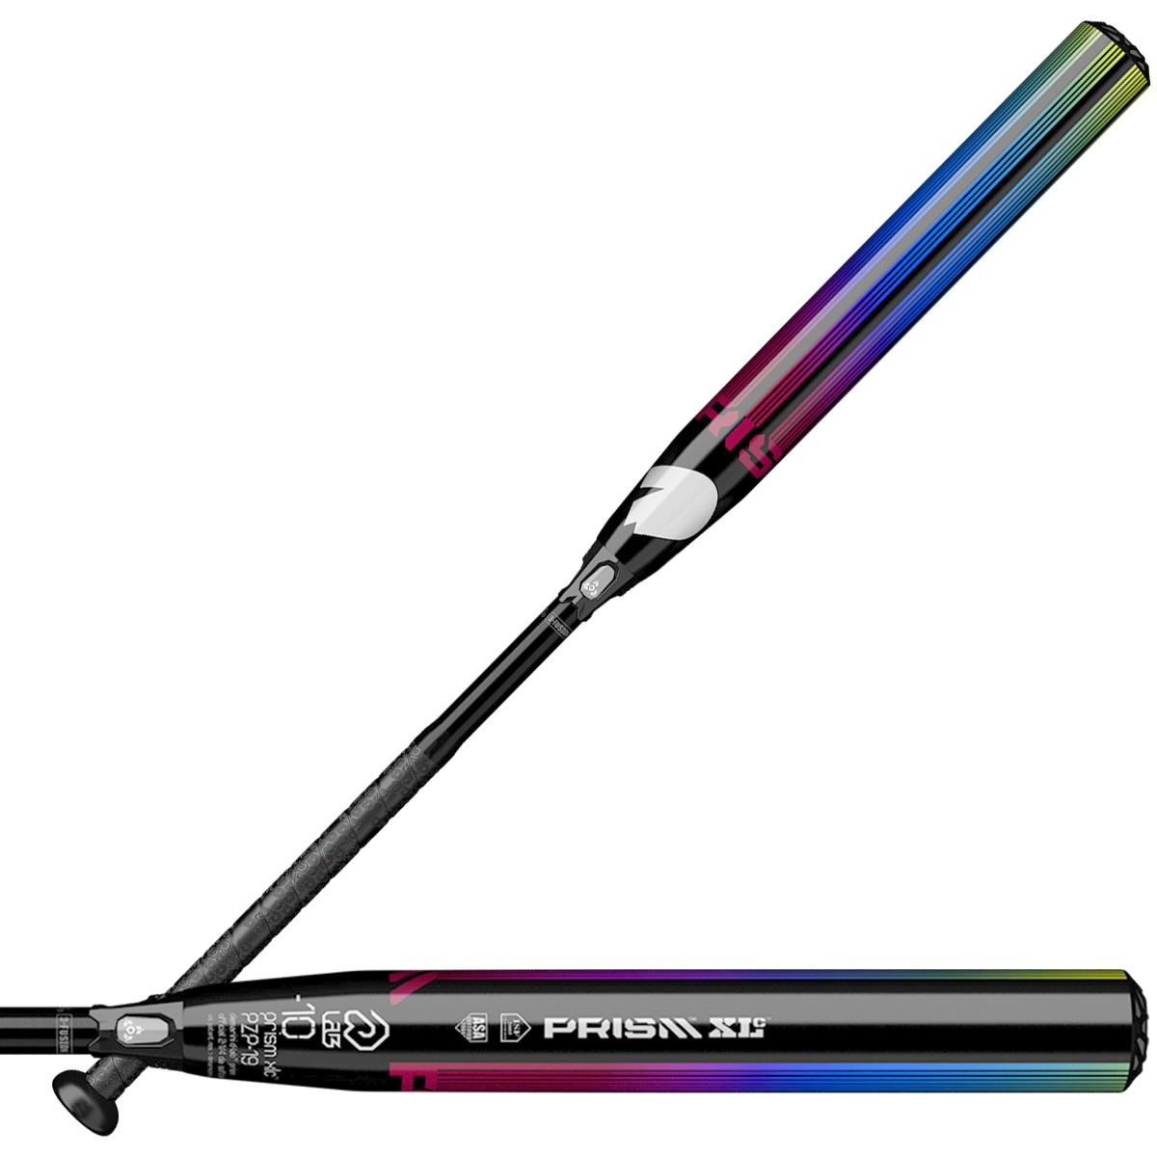
USSSA of Colorado and Wyoming
USSSA Fastpitch Points of Emphasis
COLORADO
WYOMING
2 Versions of DeMarini:
USSSA Markings
Approved
ASA/USA Markings
NON-Approved

Slide 60
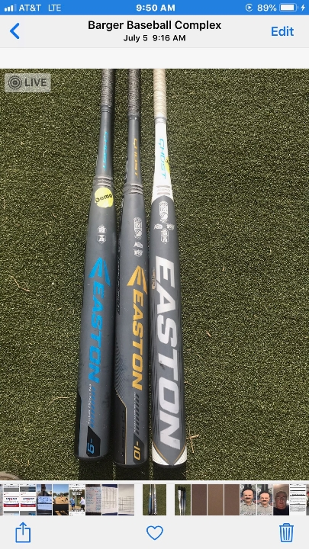
USSSA of Colorado and Wyoming
USSSA Fastpitch Points of Emphasis
COLORADO
WYOMING
Easton Ghost Bats
In order of appearance:
Blue – ASA/USA Non-Approved
Yellow – USSSA Approved
White (new) – ALL Fastpitch
Governing Bodies - Approved

Slide 61
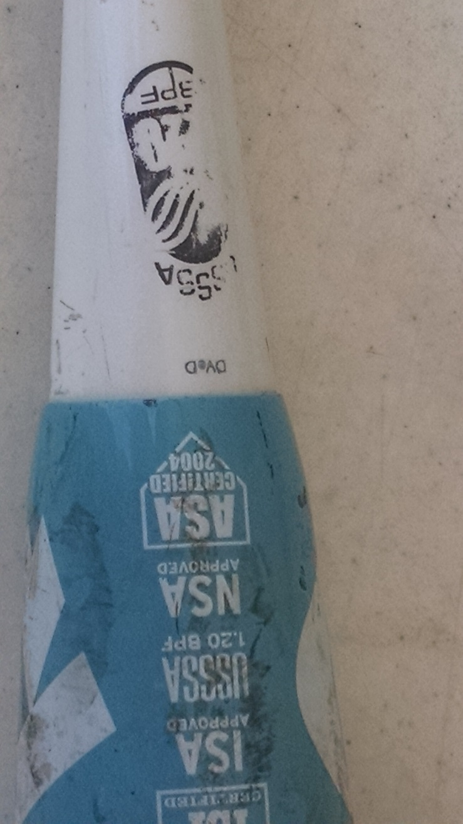
USSSA of Colorado and Wyoming
USSSA Fastpitch Points of Emphasis
COLORADO
WYOMING
Bats WILL NOT have
both certifications
Altered Bat
Penalty: Rule 2-10

Slide 62
USSSA of Colorado and Wyoming
USSSA Fastpitch “Ramblings”
COLORADO
WYOMING
State UIC email to all Umpires
Great communication tool
Not intended to “call out” or “throw under bus”
You’re encouraged to pass on information and plays for inclusion.

Slide 63
USSSA of Colorado and Wyoming
COLORADO
WYOMING
Any Questions?
Email address: larryneth@gmail.com
Phone: 303-808-4620
www.usssaofcolorado.com
www.usssa.com
www.mdumps.com/FPUmpires/FastPitchCaseBook.pdf
http://web.usssa.com/usssa/usssa-general/2017_USSSA_FPRB.pdf

Slide 64
USSSA of Colorado and Wyoming
COLORADO
WYOMING
It is your responsibility to conduct the game in a respectful and professional manner.

